Slide 1
Managing and understanding the quintuple helix towards fostering digital & responsible startups
Training Week 30 September – 4th October 2019
Thessaloniki, Greece

Slide 2
Contents
Eco-friendly (EF) / Responsible (R) and Digital (D) Business Models / Start-ups
4.
ICT Management
1.
Quintuple Helix
2.
Networking
3.
Corporate Social Responsibility

Slide 3
Quintuple Helix
Eco-friendly (EF) / Responsible (R) and Digital (D) Business Models / Start-ups
4.
ICT Management
1.
Quintuple Helix
2.
Networking
3.
Corporate Social Responsibility

Slide 4
Triple Helix – the origin of Quintuple Helix
The triple helix model of innovation refers to a set of interactions between academia, industry and governments, to foster economic and social development
This framework was first theorized by Henry Etzkowitz and Loet Leydesdorff in the 1990s
The triple helix model of Innovation is based on the interactions between the three following elements and their associated ‘initial role’:
universities providing education to individuals and engaging in basic research
industries producing commercial goods
governments that are regulating markets
"The Triple Helix Concept". Stanford University Triple Helix Research Group. 11 July 2011.
Leydesdorff, Loet (2012). "The Knowledge-Based Economy and the Triple Helix Model" . University of Amsterdam, Amsterdam School of Communications Research.
Leydesdorff, Loet; Lawton Smith, Helen. "The Triple Helix in the context of global change: dynamics and challenges"

Slide 5
Triple Helix – the origin of Quintuple Helix
TH1: etatistic model of UIS; TH2: laissez-faire policy of UIS; TH3: Triple Helix model of UIS
STATE
STATE
STATE
IND
UNI
IND
UNI
IND
UNI
Source: Etzkowitz and Leydesdorff, (2000)

Slide 6
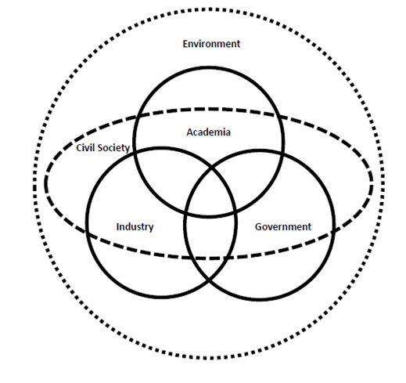
Quadruple and Quintuple Innovation Helix
The quadruple along with the quintuple innovation helix framework was co-developed by Elias G. Carayannis and David F.J. Campbell
They extended and expanded substantially the triple helix model of Innovation, as the framework introduces civil society and the environment as pillars and focal points of policy and practice

Slide 7
The five helices
Apart from active human agents, the most important constituent element of the quintuple helix is knowledge, which, through a circulation between societal subsystems, changes to innovation and know-how in a society and for the economy.
The quintuple helix visualizes the collective interaction and exchange of this knowledge in a state by means of the following five subsystems (i.e., helices):
education system
economic system
natural environment
media-based and culture-based public (also ‘civil society’)
and the political system.
Barth, Thorsten D. (2011). "The Idea of a Green New Deal in a Quintuple Helix Model of Knowledge, Know-How and Innovation". International Journal of Social Ecology and Sustainable Development. 2 (1): 6
Carayannis, Elias G.; Campbell, David F.J. (2010). "Triple Helix, Quadruple Helix and Quintuple Helix and How Do Knowledge, Innovation and the Environment Relate To Each Other?: A Proposed Framework for a Trans-disciplinary Analysis of Sustainable Development and Social Ecology". International Journal of Social Ecology and Sustainable Development. 1 (1): 46–48, 62.

Slide 8
The five helices - continued
Each of the five helices has an asset at its disposal, with a societal and scientific relevance.
The education system defines itself in reference to academia, universities, higher education systems, and schools. In this helix, the necessary ‘human capital’ (e.g., students, teachers, scientists/ researchers, academic entrepreneurs, etc.) of a state is being formed by diffusion and research of knowledge.
The economic system consists of industry/industries, firms, services and banks. This helix concentrates and focuses the economic capital (e.g., entrepreneurship, machines, products, technology, money, etc.) of a state.
The natural environment subsystem is decisive for sustainable development and provides people with natural capital (e.g., resources, plants, variety of animals, etc.).
The media-based and culture-based public subsystem integrates and combines two forms of capital. This helix has, through the culture-based public (e.g., traditions, values, etc.), a social capital. In addition, the helix of media-based public (e.g., television, internet, newspapers, etc.) contains capital of information (e.g., news, communication, social networks).
The political system formulates the will, i.e., where the state is heading, thereby also defining, organizing, and administering the general conditions of the state. Therefore, this helix has political and legal capital (e.g., ideas, laws, plans, politicians, etc.).

Slide 9
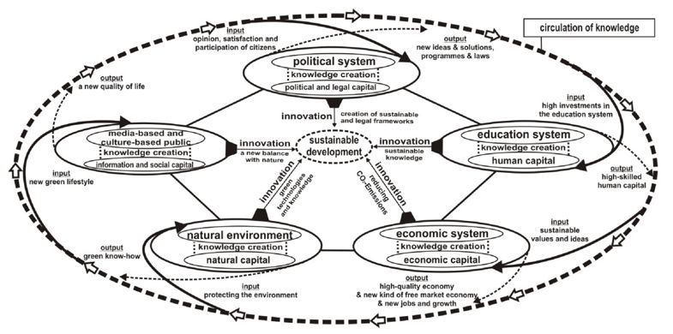
Circulation of knowledge
Carayannis, Elias G.; Barth, Thorsten D.; Campbell, David F.J. (2012). "The Quintuple Helix innovation model: global warming as a challenge and driver for innovation". Journal of Innovation and Entrepreneurship. 1 (2): 2.

Slide 10
Circulation of knowledge
Step 1: When investments flow into the education helix to promote sustainable development, they create new impulses and suggestions for knowledge creation in the education system. Therefore, a larger output of innovations from science and research can be obtained. Simultaneously, teaching and training improve their effectiveness. The output that arises from human capital for sustainable development is then an input into the economic system helix.
Step 2: Through the input of new knowledge via human capital into the economic system helix, the value of the knowledge economy consequently increases. Through the enhancement of knowledge, important further production facilitates and develops opportunities for a sustainable, future-sensitive green economy, based on knowledge creation. This knowledge creation realizes in the economic system new types of jobs, new green products and new green services, together with new and decisive impulses for greener economic growth. In this subsystem, new values, like corporate social responsibility, are demanded, enabling and supporting a new output of know-how and innovations by the economic system into the natural environment helix.

Slide 11
Circulation of knowledge
Step 3: This new sustainability as an output of the economic system is a new input of knowledge in the natural environment helix. This new knowledge ‘communicates’ to nature and results in less exploitation, destruction, contamination, and wastefulness. The natural environment can, thus, regenerate itself and strengthen its natural capital, and humanity can also learn from nature via new knowledge creation. The goal of this helix is to live in balance with nature, to develop regenerative technologies, and to use available, finite resources sustainably. Here, natural science disciplines come into play, forming new green know-how. This know-how is then an output of the natural environment subsystem into the public helix.
Step 4: The output of the natural environment results in an input of new knowledge about nature and a greener lifestyle for the media-based and culture-based public helix. Here, the media-based public receives information capital, which spreads through the media information about a new green consciousness. This capital should provide incentives on how a green lifestyle can be implemented in a simple, affordable, and conscious way, i.e., knowledge creation. This knowledge creation promotes the social capital of the culture-based public, on which a society depends for sustainable development. This know-how output then serves as new input, about the wishes, needs, problems, or satisfaction of citizens, for the political system helix.
Step 5: The input of knowledge into the political system is the know-how from the media-based and culture-based public together with the collective knowledge from the three other subsystems of society. Important discussions on this new knowledge in the political systems are necessary impulses for knowledge creation. The goal of this knowledge creation is political and legal capital, making the quintuple helix model more effective and more sustainable. Consequently, there is an output of suggestions, sustainable investments, and objectives. This leads to the circulation of knowledge back into the education system.

Slide 12
Quintuple Helix vs Eco-friendly/Responsible and Digital Business Models
EF ➔ Which elements of the Quintuple Helix influence Eco-friendly (EF)/ Responsible (R) Business Models / Start-ups ? In what way?
D ➔ Which elements of the Quintuple Helix influence Digital (D) Business Models / Start-ups ? In what way?

Slide 13
Quintuple Helix – examples and further reading
Carayannis, Elias G.; Barth, Thorsten D.; Campbell, David F.J. (2012). "The Quintuple Helix innovation model: global warming as a challenge and driver for innovation". Journal of Innovation and Entrepreneurship. 1 (2): 2
https://innovation-entrepreneurship.springeropen.com/track/pdf/10.1186/2192-5372-1-2
Social Seeds, Interreg Europe. „Methodology and Good practices on quintuple helix cooperations: Making better use of social entrepreneurship collaborations in policy improvements”
https://www.interregeurope.eu/fileadmin/user_upload/tx_tevprojects/library/file_1536063863.pdf

Slide 14
Networking
Eco-friendly (EF) / Responsible (R) and Digital (D) Business Models / Start-ups
4.
ICT Management
1.
Quintuple Helix
2.
Networking
3.
Corporate Social Responsibility

Slide 15
Networking
the process of building a network of contacts through continuous relationships
it is based on the use of everyday experience of relationships with people who live around us and with whom we have daily contact
Networking is NOT about:
soliciting
virtual contacts only
about the large number of contacts
manipulation
asking for a job or business with someone
Networking is about:
Building strong, trustful, mutually beneficial relationships!
A way to achieve goals, grow business and get to the next rung of the business ladder… together
Creating the power of „the many” in a informal group

Slide 16
Features of networking
Long-term perspective - the longer the relationship, the more solid the basis for contact
Regularity - keeping friends means more than making friends
Trust - no one will help a person if he does not trust him
Reciprocity - the most important way to get, is to give
Processability - the network is constantly changing, it is not something constant - hence it constantly requires action
Networking is based on nurturing relationships based on trust in providing mutual support, i.e. mutual benefits such as access to information, feedback or emotional support.

Slide 17
The role and the process of developing a proper networking through V-C-P
V–visibility – being visible, both online and offline, i.e. you have to be present on social networks as well as at business or social events. There we make the first impression. It is worth ensuring that it is professional.
C–credibility – Each of us builds our credibility with small activities. During business meetings, conferences, mixers, we can be perceived as engaged, responsible and helpful, or passive, not getting involved.
P–profitability – establishing a business relationship in which the parties use their services or products and pay for them.

Slide 18
Networking – further reading
Rennie, Frank; Morrison, Tara (2013). „e-Learning and Social Networking Handbook. Resources for Higher Education.” Routledge: New York.
https://books.google.pl/books?id=PrH1Y4IqsPMC&pg=PP2&lpg=PP2&dq=networking+handbook&source=bl&ots=QYPjb0Jy9j&sig=ACfU3U1s53TLLSNvq9y3CdKLi2PnjNkN6Q&hl=pl&sa=X&ved=2ahUKEwiB9ouar-rkAhVt7aYKHXcnDPQ4ChDoATAGegQICRAB#v=onepage&q=networking%20handbook&f=false

Slide 19
Corporate Social Responsibility
Eco-friendly (EF) / Responsible (R) and Digital (D) Business Models / Start-ups
4.
ICT Management
1.
Quintuple Helix
2.
Networking
3.
Corporate Social Responsibility

Slide 20
Corporate Social Responsibility (CSR) - definition
Corporate social responsibility (CSR) is a type of international private business self-regulation that aims to contribute to societal goals of a philanthropic, activist, or charitable nature or by engage in or support volunteering or ethically-oriented practices.
Sheehy, Benedict "Defining CSR: Problems and Solutions". Journal of Business Ethics. 131 (3): 625–648.
Lee, Nancy; Kotler, Philip (2013). Corporate social responsibility doing the most good for your company and your cause. Hoboken, NJ: Wiley.
Carroll, Archie B. (July 1991). "The pyramid of corporate social responsibility: Toward the moral management of organizational stakeholders". Business Horizons. 34 (4): 39–48.

Slide 21
Corporate Social Responsibility (CSR) - definition
Since the 1960s, corporate social responsibility has attracted attention from a range of businesses and stakeholders.
A wide variety of definitions have been developed but with little consensus.
Part of the problem with definitions has arisen because of the different interests represented:
A business person may define CSR as a business strategy
an NGO activist may see it as 'greenwash‚
while a government official may see it as voluntary regulation.
Sheehy, Benedict "Defining CSR: Problems and Solutions". Journal of Business Ethics. 131 (3): 625–648.
Lee, Nancy; Kotler, Philip (2013). Corporate social responsibility doing the most good for your company and your cause. Hoboken, NJ: Wiley.
Carroll, Archie B. (July 1991). "The pyramid of corporate social responsibility: Toward the moral management of organizational stakeholders". Business Horizons. 34 (4): 39–48.

Slide 22
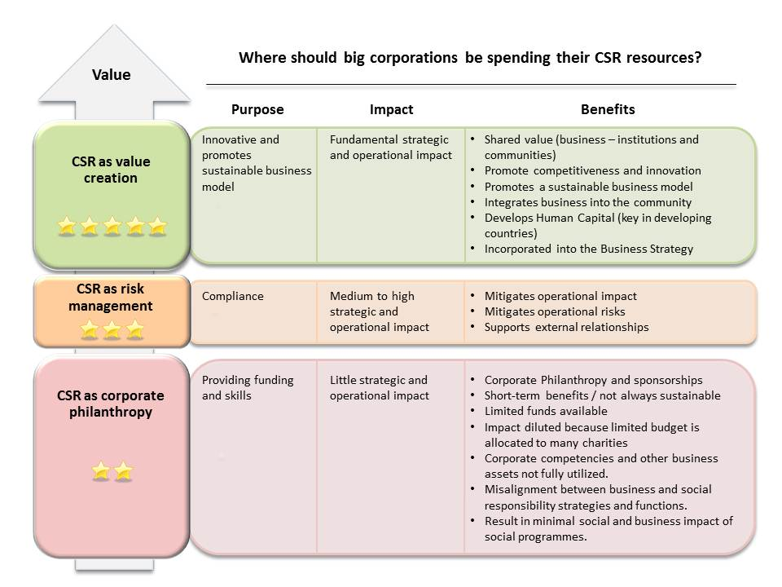
CSR approaches
Saether, Kim T.; Aguilera, Ruth V. (2008). "Corporate Social Responsibility in a Comparative Perspective". In Crane, A.; et al. (eds.). The Oxford Handbook of Corporate Social Responsibility. Oxford University Press. ISBN 978-0-19-921159-3. Archived from the original
Maverlinn and Vermander, B. (2013). "Corporate Social Responsibility in China: A Vision, an Assessment and a Blueprint, World Scientific".
Knox, Simon (2007). Ramsden, J.J.; Aida, S. and; Kakabadse, A (eds.). Corporate Social Responsibility and Business Decision Making. Spiritual Motivation: New Thinking for Business and Management. Basingstoke: Palgrave Macmillan.
Tilcsik, András; Marquis, Christopher (1 February 2013). "Punctuated Generosity: How Mega-events and Natural Disasters Affect Corporate Philanthropy in U.S. Communities". Administrative Science Quarterly. 58 (1): 111–148.

Slide 23
Corporate social initiatives
Corporate social responsibility includes six types of corporate social initiatives:
Corporate philanthropy: company donations to charity, including cash, goods, and services, sometimes via a corporate foundation
Community volunteering: company-organized volunteer activities, sometimes while an employee receives pay for pro-bono work on behalf of a non-profit organization
Socially-responsible business practices: ethically produced products which appeal to a customer segment
Cause promotions and activism: company-funded advocacy campaigns
Cause-related marketing: donations to charity based on product sales
Corporate social marketing: company-funded behavior-change campaigns

Slide 24
Common CSR actions
Common CSR actions include:
Environmental sustainability: recycling, waste management, water management, renewable energy, reusable materials, 'greener' supply chains, reducing paper use.
Community involvement: This can include raising money for local charities, providing volunteers, sponsoring local events, employing local workers, supporting local economic growth, engaging in fair trade practices, etc.
Ethical marketing: Companies that ethically market to consumers are placing a higher value on their customers and respecting them as people who are ends in themselves. They do not try to manipulate or falsely advertise to potential consumers. This is important for companies that want to be viewed as ethical.
Jones, Tegan (2007-05-14). "Talent Management". The Business Value of Virtue: Corporate Social Responsibility and Employee Engagement.
Matthews, Richard (2012-01-26). "The Green Market Oracle". Top Business Sustainability Trends for 2012.
"Great Forest". Services. 2013.
"Environmental Leader". Top Sustainability Consultants Revealed.
"Camden Community Empowerment Network". Camden Community Empowerment Network Jargon Buster.
"Workforce Management". Starbucks is Pleasing Employees and Pouring Profits. October 2003. pp. 58–59.

Slide 25
Common CSR actions
EF ➔ How CSR actions can be embedded into Eco-friendly (EF) / Responsible (R) Business Models / Start-ups?
D ➔ How CSR actions can be embedded into Digital (D) Business Models / Start-ups ?

Slide 26
CSR – examples and further reading
Clinton, Lindsay; Whisnant, Ryan (2014). „20 Business Model Innovations for Sustainability”
https://sustainability.com/wp-content/uploads/2016/07/model_behavior_20_business_model_innovations_for_sustainability.pdf

Slide 27
ICT Management
Eco-friendly (EF) / Responsible (R) and Digital (D) Business Models / Start-ups
4.
ICT Management
1.
Quintuple Helix
2.
Networking
3.
Corporate Social Responsibility

Slide 28
ICT Information and Communications Technology
ICT - is an umbrella term that includes any communication device or application.
It encompass mobile phones, computer and network hardware and software, radio, television, satellite systems and more.
It encompass various services and applications associated with them, such as data transfer, e-transactions, cloud computing, videoconferencing and more.

Slide 29
ICT – digital revolution
Internet of Things
Cloud computing
Hyperconnectivity
Big Data Analytics
Multi-channel distribution
Automation
Driving forces
Internet
Apps
Cameras
Scanning
GPS/SatNav
Communication
Source: Pieriegud, 2016

Slide 30
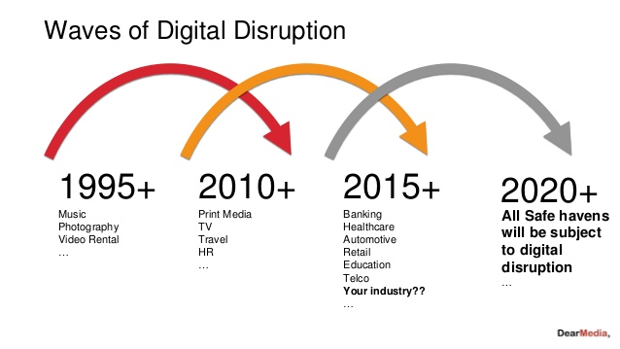
More and more of „digital sectors”

Slide 31
ICT use intensity – what happens in an Internet minute?
2017 (billions)
World population – 7,5
mobile services coverage – 7,0
Mobile unique users – 5,0
Internet users – 3,8
Active social media users – 2,9
60 seconds in Internet (2019)
YouTube – 4,5 mln video views
Google – 3,8 mln querries
messages (Messenger/WhatsApp) – 18,1 mln sent
AppStore – 390.050 app downloads
Netflix – 694.444 hours watched
e-trade – 997.000 $ in sales
Source: visualcapitalist.com, 2019
Source: Global Digital Snapshot, 2018

Slide 32
ICT sectors – OECD approach
ICT sector can be defined according to the definition provided by the OECD on the basis of the NACE (Statistical Classification of Economic Activities in the European Community) Rev.2 (2008) nomenclature.
The ICT sector has 12 sub-sectors:
ICT manufacturing
C261 Manufacture of electronic components and boards
C262 Manufacture of computers and peripheral equipment
C263 Manufacture of communication equipment
C264 Manufacture of consumer electronics
C268 Manufacture of magnetic and optical media
ICT services
G4651 Wholesale of computers, computer peripheral equipment and software
G4652 Wholesale of electronic and telecommunications equipment and parts
J5820 Software publishing
J61 Telecommunications
J62 Computer programming, consultancy and related activities
J631 Data processing, hosting and related activities; web portals
S951 Repair of computers and communication equipment

Slide 33
ICT Management
ICT Management – different levels of analysis
National, regional, sectoral, company level of management
ICT Management at company level – four main categories selected according to how business minded they are.
It is essential to have capabilities and expectations in balance.
ICT Management
Knowledge area
[ICT technical knowledge]
Support function
[suport for internal users]
Management function
[ICT role in the company]
Business function
[suport for effectiveness]
Source: Huovinen, 2010

Slide 34
ICT Management
ICT management fuctions
Knowledge management
ICT requires specific skills in certain knowledge areas and the individuals responsible have these tasks included in their job descriptions. ICT can be identified as the ICT department, and it may have an ICT Manager.
Support function
well managed support function is driven by the business, but the ICT operations themselves are managed independently. Support function should be responsible for it’s own budget and is directly or indirectly represented in the Top Executive Management team of the company. The main objective of a support function is to ensure the ICT services are meeting business needs, are reliable and cost effective.
Management function
in case of ICT should be at the same level as other business areas. It is common to include the development of processes in this function. The governance methods are typically clear and developed in order to ensure that the function remains efficient and results oriented amongst all business issues. The Management function should has a seat in the Top Executive Management team.
Business function
ICT services are a key element of the company’s products or services offerings and a part of the income can be identified directly to it. The function is therefore a real profit center and it also carries a part of the business risk. ICT management can only become a business function in especially ICT intensive businesses. Incorporating ICT does not mean that it would automatically become a business function...
Source: Huovinen, 2010

Slide 35
ICT at country level ICT Development Index (IDI)
IDI is an index published by the United Nations International Telecommunication Union
It bases on information and communication technologies (ICT) indicators.
IDI is the tool for benchmarking the most important indicators for measuring the information society.
Governments, operators, development agencies, researchers and others can use IDI to measure and compare ICT performance within and across countries.
IDI is based on 11 ICT indicators, grouped in three clusters: access, use and skills.

Slide 36
ICT Management – further reading
Cedefop (2018). Handbook of ICT practices for guidance and career development. Luxembourg: Publications Office.
http://data.europa.eu/doi/10.2801/368695
Gatautis, R.; Medziausiene, A.; Tarute, A.; Vaiciukynait, E. (2015) Towards ICT Impact Framework: Private and Public Sectors Perspective, Journal of Economics, Business and Management, Vol. 3, No. 4, April.

Slide 37
Managing and understanding the quintuple helix towards fostering digital & responsible startups
Questions? Comments? Feedback?
Training Week 30 September – 4th October 2019
Thessaloniki, Greece

